Slide 1
Cornerstone City Church Peninsula Plus Community Hoo Are Ya
14th September 2025

Slide 2
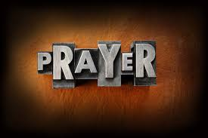

Slide 3
I Thank God
CCLI Song # 7169680
Aaron Moses | Chuck Butler | Dante Bowe | Enrique Holmes | Jesse Cline | Maryanne J. George
© 2021 Aaron Moses Chiriboga Music; Be Essential Songs; Holmeboy Music Group; Jesse Cline Publishing Designee; Jord A Lil Music; Bethel Worship Publishing; Heritage Worship Music Publishing; Maverick City Publishing; MJ George Music
For use solely with the SongSelect® Terms of Use. All rights reserved. www.ccli.com

Slide 4
1/8
Wandering into the night wanting a place to hide
This weary soul this bag of bones
I try with all of my might
But I just can't win the fight
I'm slowly drifting a vagabond

Slide 5
2/8
And just when I ran out of the road
I met a man I didn't know
And He told me that I was not alone

Slide 6
3/8
You picked me up You turned me around
And placed my feet on solid ground
I thank the Master I thank the Savior
Because You healed my heart You changed my name
Forever free I'm not the same
I thank the Master I thank the Savior I thank God

Slide 7
4/8
I cannot deny what I've seen
Got no choice but to believe
My doubts are burnin' like ashes in the wind
So so long to my old friends
Burden and bitterness
You can just keep them moving
Nah you ain't welcome here

Slide 8
5/8
From now till I walk streets of gold
I'll sing of how You saved my soul
This wayward son has found his way back home

Slide 9
6/8
You picked me up You turned me around
And placed my feet on solid ground
I thank the Master I thank the Savior
Because You healed my heart You changed my name
Forever free I'm not the same
I thank the Master I thank the Savior I thank God

Slide 10
7/8
Hell lost another one
I am free I am free I am free
(REPEAT)
Hell lost another one
I am free I am free

Slide 11
8/8
You picked me up You turned me around
And placed my feet on solid ground
I thank the Master I thank the Savior
Because You healed my heart You changed my name
Forever free I'm not the same
I thank the Master I thank the Savior I thank God

Slide 12
House Of The Lord
CCLI Song # 7168995
© 2020 Phil Wickham MusicSimply Global SongsBe Essential SongsCashagamble Jet Music
For use solely with the SongSelect® Terms of Use. All rights reserved. www.ccli.com
Note: Reproduction of this sheet music requires a CCLI Music Reproduction Licence. Please report all copies.
CCLI Licence No. 33265

Slide 13
1/9
We worship the God who was
We worship the God who is
We worship the God who evermore will be
He opened the prison doors
He parted the raging sea
My God He holds the victory yeah

Slide 14
2/9
There’s joy in the house of the Lord
There’s joy in the house of the Lord today
And we won’t be quiet
We shout out Your praise

Slide 15
3/9
There’s joy in the house of the Lord
Our God is surely in this place
And we won’t be quiet
We shout out Your praise

Slide 16
4/9
We sing to the God who heals
We sing to the God who saves
We sing to the God who always makes a way
'Cause He hung up on that cross
Then He rose up from that grave
My God’s still rolling stones away

Slide 17
5/9
There’s joy in the house of the Lord
There’s joy in the house of the Lord today
And we won’t be quiet
We shout out Your praise

Slide 18
6/9
There’s joy in the house of the Lord
Our God is surely in this place
And we won’t be quiet
We shout out Your praise

Slide 19
7/9
We were the beggars
Now we’re royalty
We were the prisoners
Now we’re running free
We are forgiven accepted
Redeemed by His grace
Let the house of the Lord sing praise
(REPEAT)

Slide 20
8/9
There’s joy in the house of the Lord
There’s joy in the house of the Lord today
And we won’t be quiet
We shout out Your praise

Slide 21
9/9
There’s joy in the house of the Lord
Our God is surely in this place
And we won’t be quiet
We shout out Your praise

Slide 23
Great Are You Lord
CCLI Song # 6460220
David Leonard | Jason Ingram | Leslie Jordan
© 2012 Open Hands Music (Admin. by Essential Music Publishing LLC)
So Essential Tunes (Admin. by Essential Music Publishing LLC)
Integrity's Praise! Music (Admin. by Integrity Music Ltd)
Little Way Creative (Admin. by Integrity Music Ltd)
For use solely with the SongSelect® Terms of Use. All rights reserved. www.ccli.com
CCLI Licence No. 33265

Slide 24
1/3
You give life You are love
You bring light to the darkness
You give hope You restore ev'ry heart that is broken
And great are You Lord

Slide 25
2/3
It's Your breath in our lungs
So we pour out our praise
We pour out our praise
It's Your breath in our lungs
So we pour out our praise to You only

Slide 26
3/3
And all the earth will shout Your praise
Our hearts will cry these bones will sing
Great are You Lord
(REPEAT)

Slide 27


Slide 28
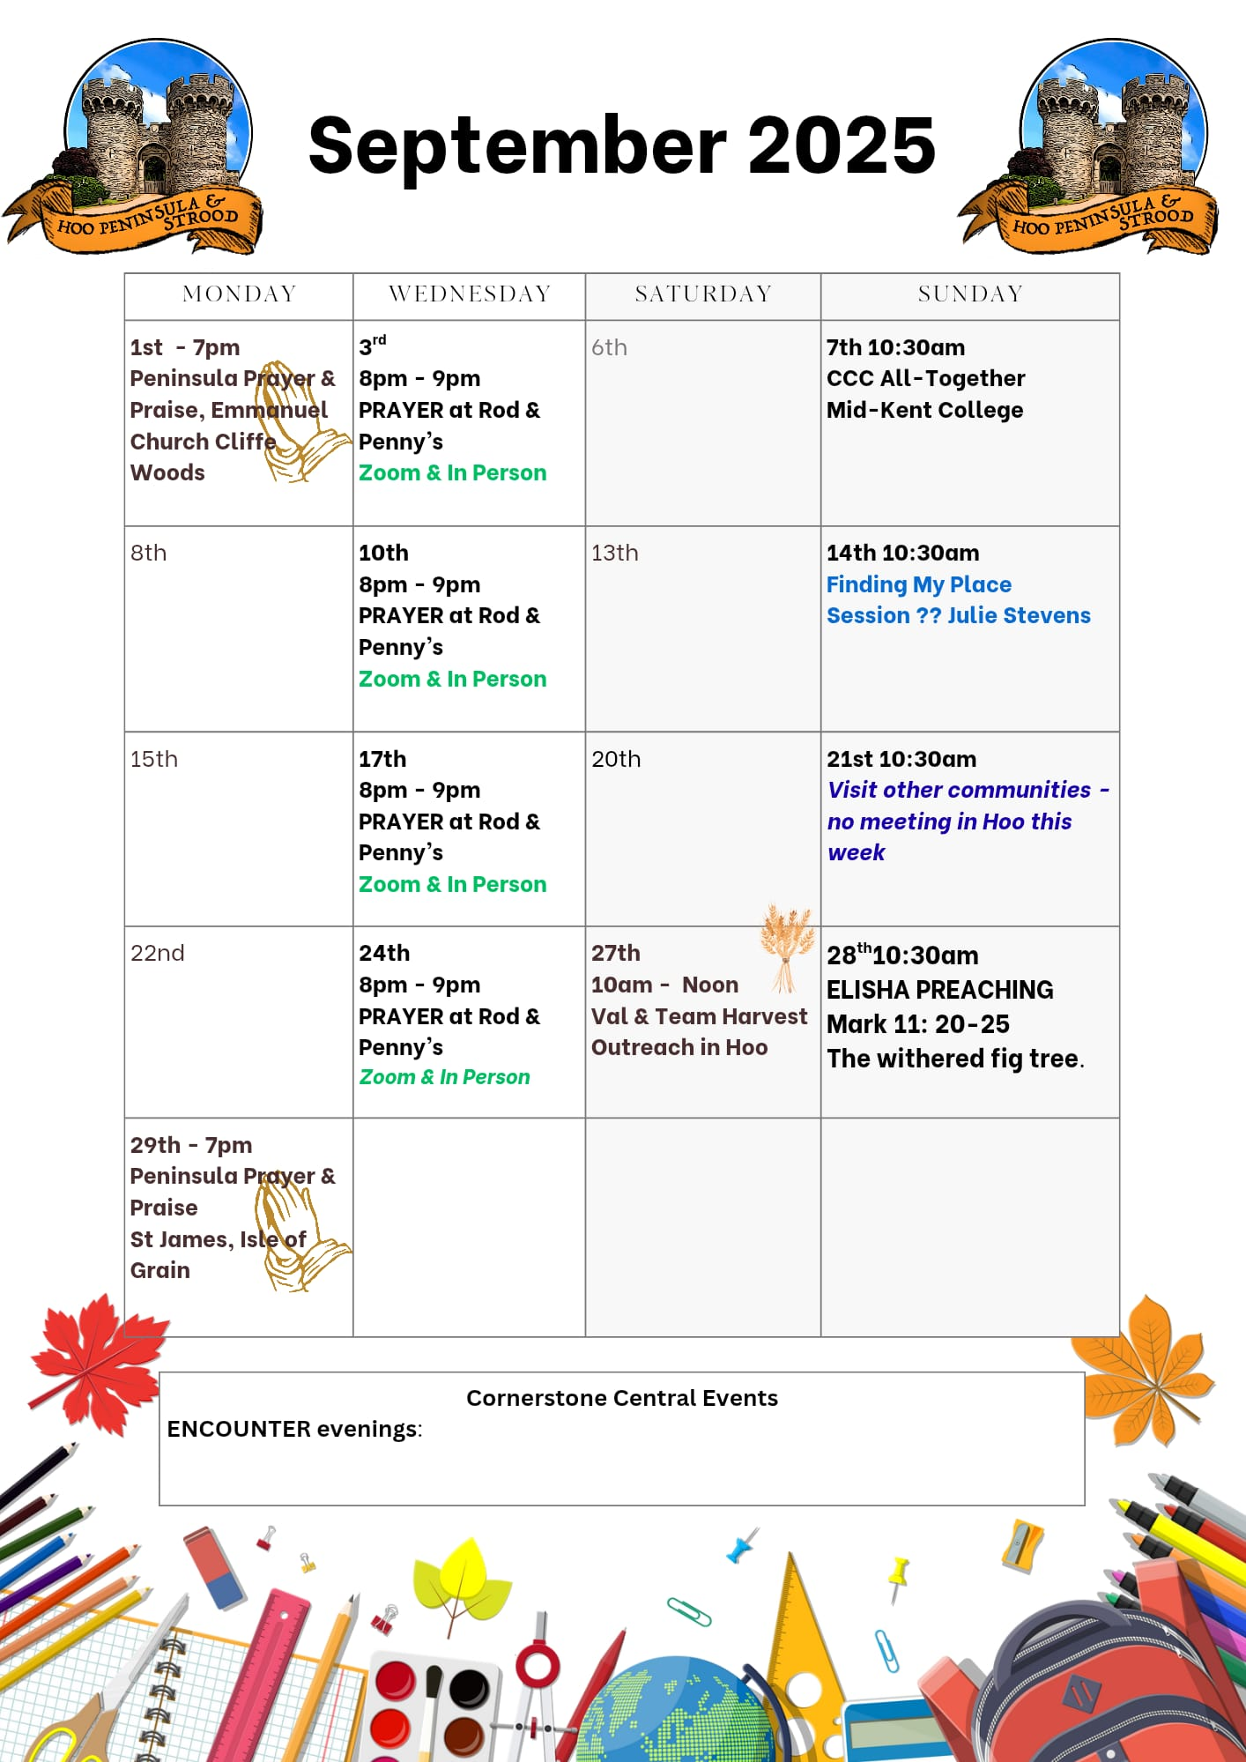

Slide 29

Grow Group 1
On YOUR MARK!

Slide 30
Leaders
Leaderss
Phil & Kim
Maria (Mia) Warren
Matthew Harrison
Richard & Elisha Acheampong
Phil & Kim
Maria (Mia) Warren
Matthew Harrison
Richard & Elisa Acheampong

Slide 31
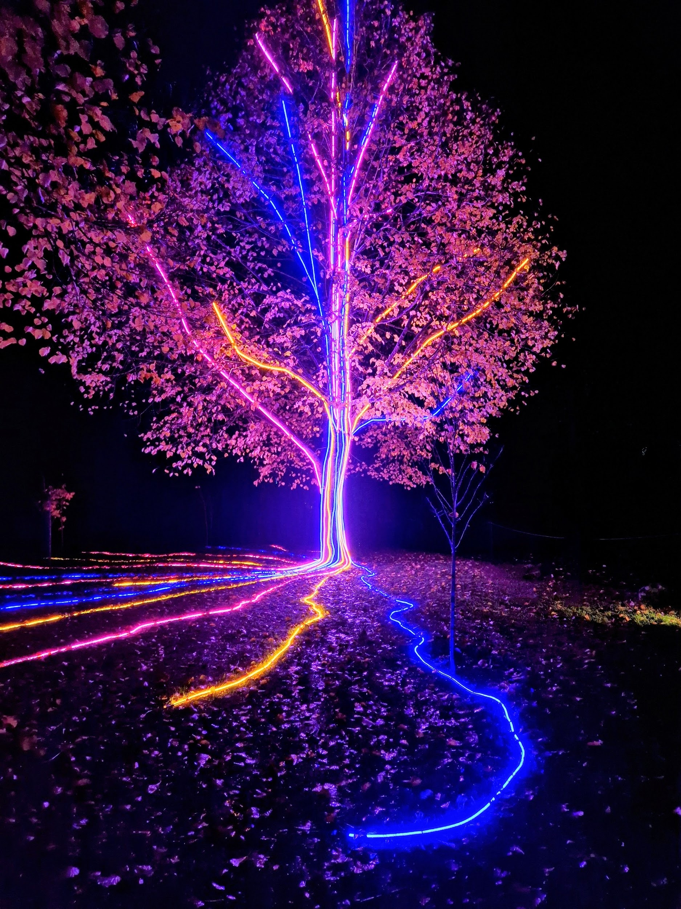
Storm Walker
Storm Walker
Symbolising, trust in Jesus Christ through life's storms.
Mark 4:35-41

Slide 32



Group Leaders
Micheal and Mwamba
Wilfred and Parveen
Hannah

Slide 33


Slide 34


Slide 35
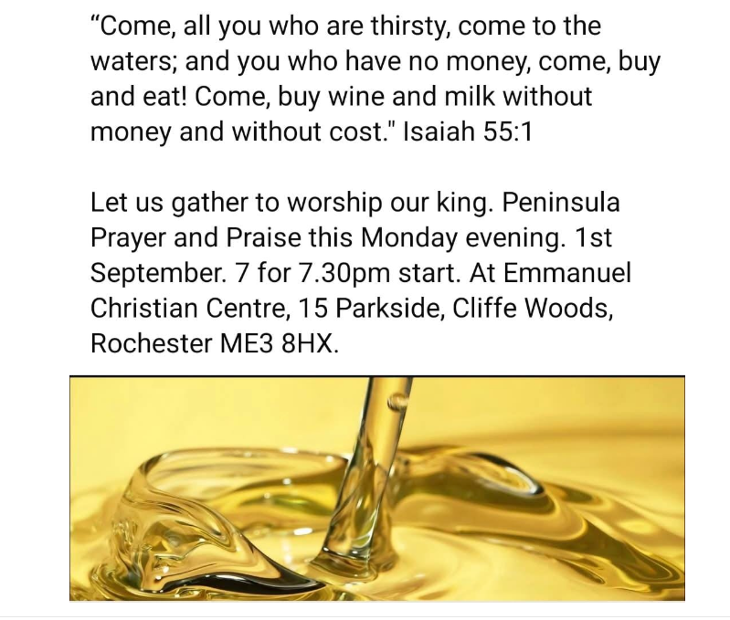

Slide 36


Slide 37
2 Corinthians 14 May the grace of the Lord Jesus Christ, and the love of God, and the fellowship of the Holy Spirit be with you all
Surely goodness and mercy shall follow us all the days of our lives, and we shall dwell in the house of the Lord forever.

